Slide 1
Credit Card Fraud Detection Analytics
Authored by:
Srikrishnan Shankar

Slide 2
Overview
This Dataset contains information about Transactions of Credit Cards from the user up to 284807 entities and 31 features.
Well very few Transactions seems to be Fraudulent, and it is mapped in the dataset as column name as Class, which as 1 and 0.
Class = 1 means Fraud Transaction and Class = 0 Means Normal Transaction.
The main agenda of this project is to:
Do Data Preprocessing, to clean the Data.
Perform Exploratory Data Analysis, to find some Insights.
Define the Key Performance Indicator Metric from the Findings.
Do Feature Engineering to make the Data Consistent.
Build Machine Learning Models to detect the given input Transaction Details are whether Genuine or Fraudulent.

Slide 3
Tools Used
Python
Tableau

Slide 4





Content Title
Data Pre-Processing
Exploratory Data Analysis
Data Visualization Dashboard
Feature Engineering
Machine Learning Model Development

Slide 5
1) Data Pre-Processing
Data Pre-processing is the primary step of any Data Analytics or Data Science Project.
Although in this project we didn’t had a lot of work on Data Pre-Processing except the Duplicate Values.
For the Class = 0, means for Genuine Transaction the number of duplicated values are: 1062 and for Class = 1, Fraudulent Transactions are: 19.
We decided to Drop the duplicates using Pandas Method in Python, df.drop_duplicates().

Slide 6
2) Exploratory Data Analysis
Exploratory Data Analysis is a very important process in a Data Science Project.
In this project we have conducted Uni-Variate, Bi-Variate & Multi-Variate Analysis.
Uni-Variate Analysis, is conducted to explore the Distribution of the Individual Features.
Bi-Variate Analysis, is conducted to explore the Distribution of the Data between the Two Variables and How they are Related.
Multi-Variate Analysis, is conducted to explore the Data with more than 2 Features.

Slide 7
3) Key Performance Indicator (KPI) Analytics
KPI 1: Total Number of Transactions, 283745
KPI 2: Average Transaction Amount, 88.47
KPI 3: Average Time Taken for Each Transactions, 26.34
KPI 4: Fraud Transaction Rate, 0.2%
KPI 5: Distribution of Normal Transaction Amount vs Time, Avg Time is 26.34 & Avg Amount is 88.41
KPI 6: Distribution of Fraud Transaction Amount vs Time, Avg Time is 22.42 & Avg Amount is 122.21

Slide 8
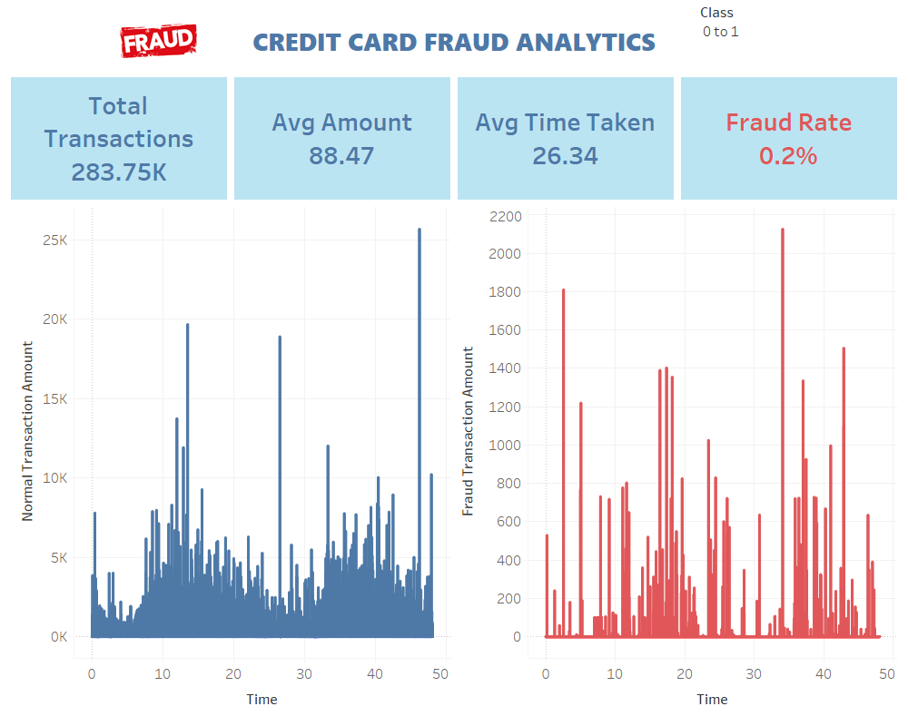
Credit Card Fraud Analytics Dashboard

Slide 9
4) Feature Engineering
Feature Engineering is must process in a project of Data Science.
Basically during Feature Engineering we will make the Data Consistent by Scaling and Make is numeric through Encoding process for the ML Models to interpret and provide the prediction.
In our case We had to Scale the Data to make it consistent for the ML Models.
And additionally we had to perform the Sampling techniques, such as SMOTE & ADASYN to perform over-sampling in the Dataset, since the Samples of the Dataset was Biased, like Class 0 had way more samples than Class 1, therefore this might affect our models during the prediction.

Slide 10
5) Data Pre-Processing
Data Pre-processing is the primary step of any Data Analytics or Data Science Project.
Although in this project we didn’t had a lot of work on Data Pre-Processing except the Duplicate Values.
For the Class = 0, means for Genuine Transaction the number of duplicated values are: 1062 and for Class = 1, Fraudulent Transactions are: 19.
We decided to Drop the duplicates using Pandas Method in Python, df.drop_duplicates().

Slide 11
1) Model Development
This is the Final step of this project, here we are building Classification Models for Predicting Binary Classes in the Dataset.
The Models that we used are:
Logistic Regression
Decision Tree
Random Forest
K Nearest Neighbors
Kernel Support Vector Machines
XG Boost Classification

Slide 12
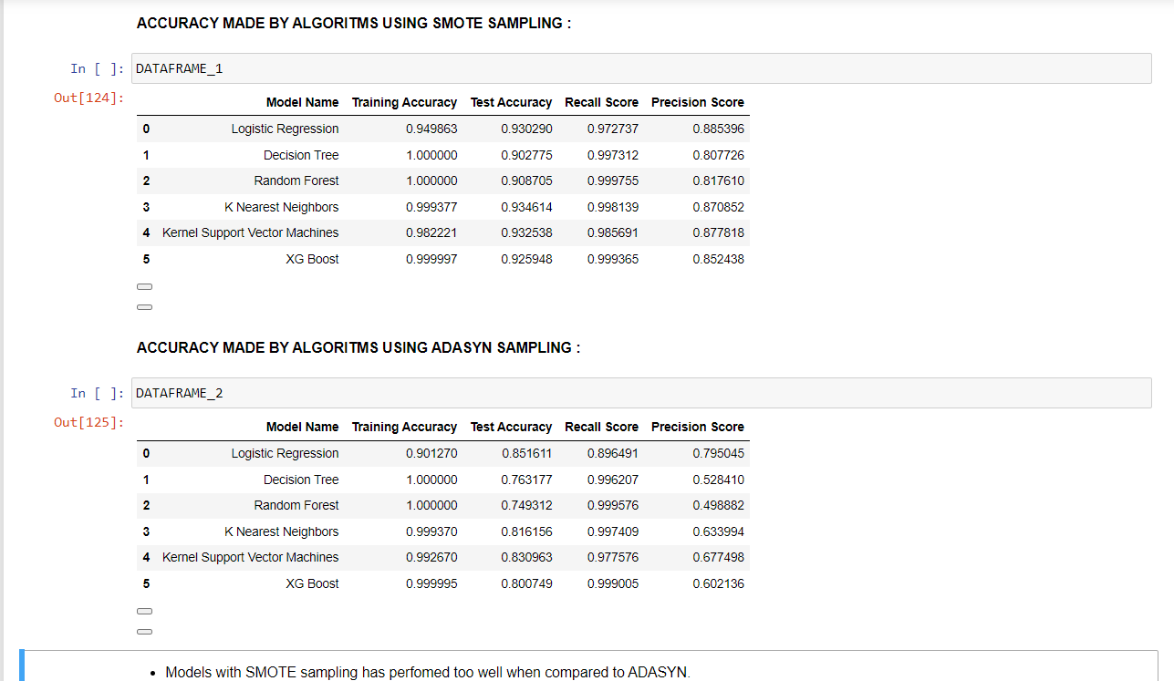
Model Evaluation Table

Slide 13
Conslusion
Random Forest Models Seems to be has performed well compared to other models, therefore we will Deploy the Random Forest Model by dumping into Pickle File and also we Will Extract the Column Information and write it on json file.

Slide 14
Thank You
Name: Srikrishnan Shankar
Email ID: srikrishnan214@gmail.com

